Slide 1
Multi-Resolution Shared Representative Filtering for Real-Time Depth Completion
High-Performance Graphics 2021
Yu-Ting Wu National Taiwan University
Tzu-Mao Li Massachusetts Institution of Technology CSAIL
I-Chao Shen The University of Tokyo
Hong-Shiang Lin FIH Mobile Limited
Yung-Yu Chuang National Taiwan University
Date: July 6, 2021
Notes:
Hello, I am Yu-Ting Wu from National Taiwan University.
I would like to present our work, Multi-Resolution Shared Representative Filtering for real-time depth completion.

Slide 2
Outline
Introduction
Related Work
Shared Representative Filtering (SRF)
Multi-Resolution SRF
Results
Conclusion and Future Work
02
Notes:
This is the outline of today’s presentation.

Slide 3
Introduction
Notes:
I will start by introducing our motivation.

Slide 4
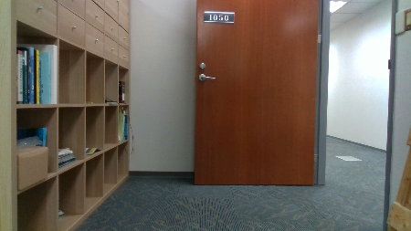
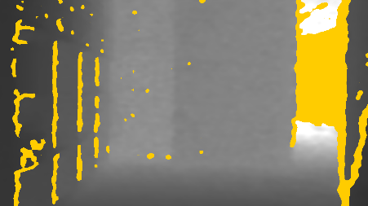
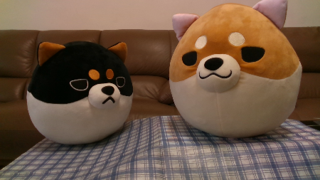
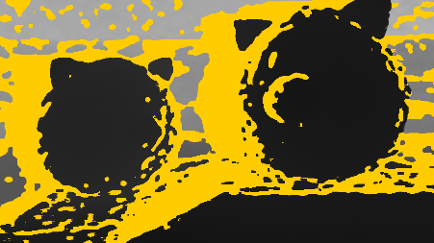
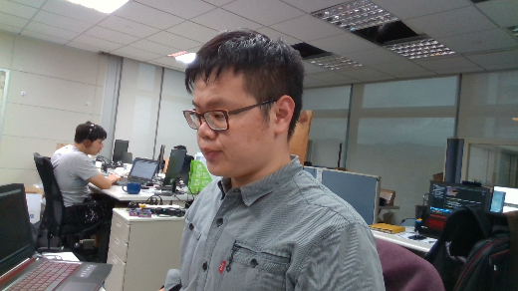
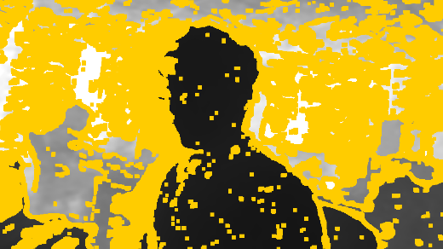
Motivation
Depth maps captured by today’s depth sensors contain holes due to
Lack of features
Surface properties
Distance to the camera
Occlusion
yellow pixels are pixels with invalid depths
04
Notes:
Despite the fast improvement of depth sensors, the depth maps captured by today’s devices still contain missing regions due to lack of features, shiny surface, distance to the camera, and occlusion.

Slide 5
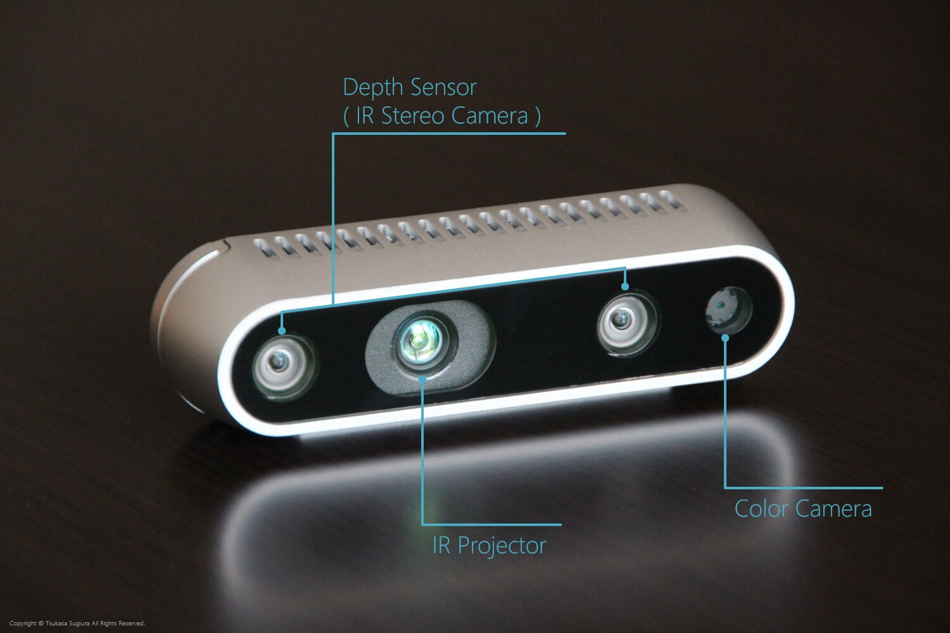
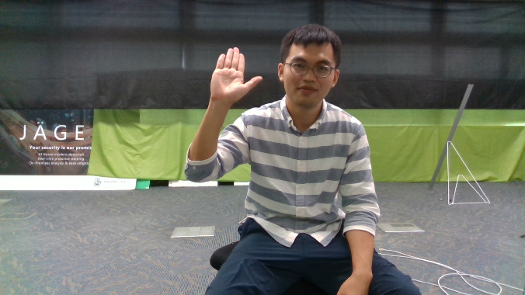
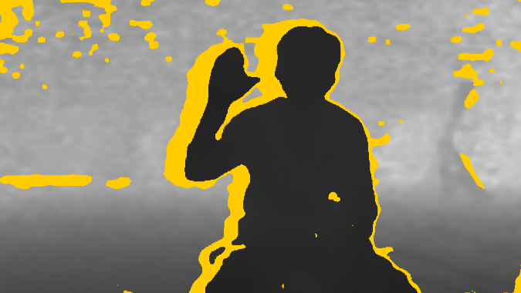
Motivation
For RGB-D cameras, aligning the depth map to its corresponding color image also produces holes
Due to the disparities between camera sensors
05
Notes:
For RGB-D cameras, missing regions can also occur when we align a depth map to its corresponding color image, due to the disparities between the depth and color sensors.

Slide 6
Motivation
Our goal: fill the holes efficiently and correctly
Difficult for real-time applications because of very tight time budgets
For example: a 60-fps application has only 16ms for each frame and depth completion is only one step among them
➔ Preclude the usage of high-quality, offline methods
06
Notes:
Our goal is to fill the holes efficiently and correctly.
(click) For real-time applications, this is especially challenging because of the limited time budgets.
(click) For example, in AR or MR applications, we need to achieve 60 frames per second, which means we only have 16 ms. for all tasks in a frame, and depth completion is only one step among them.

Slide 7
Joint Bilateral Filtering [Kopf et al. 2007]
Estimate the depth value of an invalid pixel by taking the weighted average of its nearby valid samples within a fixed local window
High Parallelism
07
Notes:
One popular approach for real-time depth completion is joint bilateral filtering.
(click) It estimates the depth value of an invalid pixel by taking the weighted average of its nearby valid samples, within a fixed local window.
(click) It is fast because all pixels can run in parallel.

Slide 8
Joint Bilateral Filtering [Kopf et al. 2007]
However, joint bilateral filtering is not efficient/accurate when the holes are large
Consider a toy example:
Input Color
Ground Truth Depth
Input Depth
08
Notes:
However, when the holes are large, joint bilateral filtering becomes less effective
(click) Let’s consider this toy example of two planes with similar colors.

Slide 9
Joint Bilateral Filtering [Kopf et al. 2007]
Dilemma for choosing filter size
Small kernel:
Large kernel:
cannot fill all holes
/ inaccurate results
oversmooth (include too many samples from different 3D surfaces)
/ time consuming
Small Kernel (3 x 3)
Large Kernel (9 x 9)
09
Notes:
When using joint bilateral filters, we will face a dilemma for choosing the filter size.
(click) If we choose a small kernel,
(click) it may fail to fill all holes.
(click) It can also produce very inaccurate results if all valid samples within the window are on the other surface.
(click) On the other hand, if we enlarge the filter size,
(click) we might include too many samples from different 3D surfaces and over smooth the depth boundaries.
(click) It also takes more time to use large filters.

Slide 10
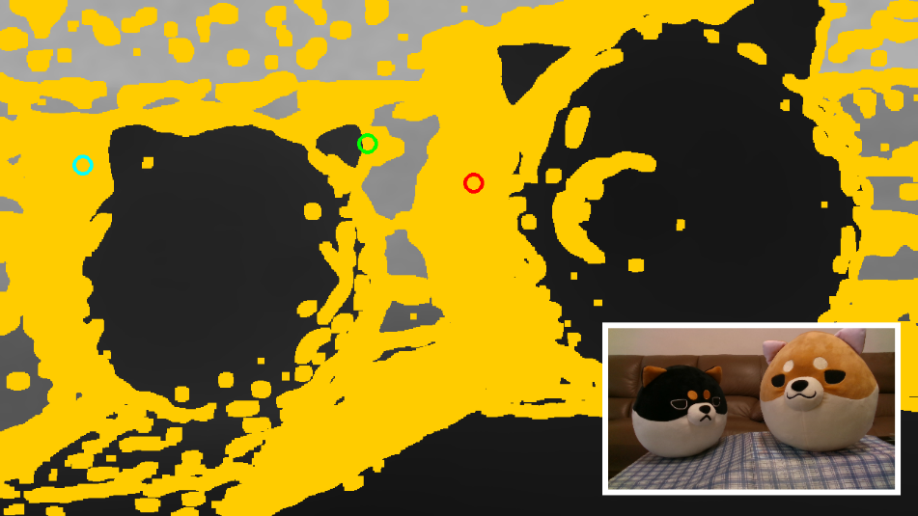
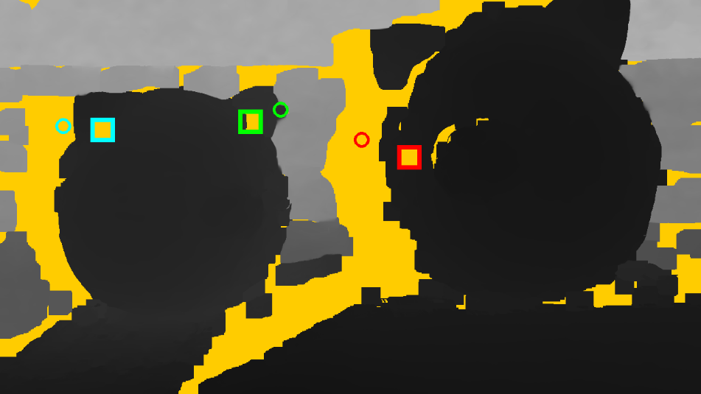
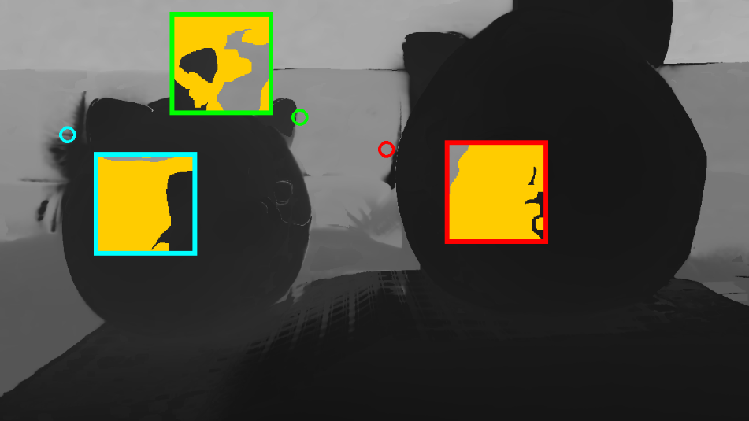
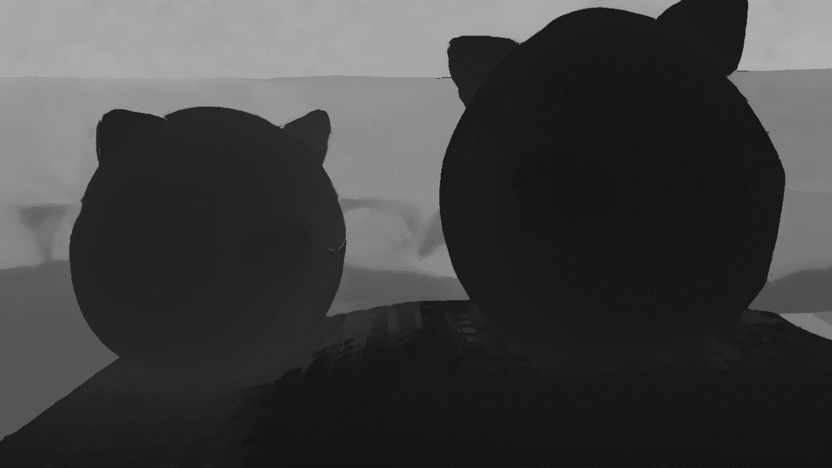
Joint Bilateral Filtering [Kopf et al. 2007]
Inputs
35x35 JBF (7.5 ms.)
181x181 JBF (166.7 ms.)
Our method (7.5 ms.)
10
Notes:
This page shows a real example of the dilemma.
After removing unreliable pixels, the depth map captured by RealSense has 44% invalid pixels.
(click) Using a filter of size 35 cannot fill all holes in one pass.
(click) Using a large filter will over smooth the object boundaries.
(click) Our method successfully preserves object boundaries while running in real time.

Slide 11
Our Contributions
We propose a new filtering-based method for real-time depth completion
Effective for large holes
Adapt to hole shapes and better preserve depth boundaries
Retain the advantage of filtering-based methods
High parallelism
11
Notes:
Let me disclose our major contributions.
We propose a new filtering-based method for real-time depth completion.
(click) Our method can adapt to hole shapes and better preserve depth boundaries.
(click) Our method is also fast because it retains the advantage of conventional filtering-based methods.

Slide 12
Related Work
Notes:
Before I introduce our method, lets review some previous filtering-based approaches.

Slide 13
Previous Filtering-based Methods
Joint bilateral filtering and its variants
Multi-resolution joint bilateral upsampling [Richardt et al. 2012]
Filter in higher-dimensional space [Adams et al. 2009; Gastal and Oliveria 2012; Barron and Poole 2016]
Hardware-friendly bilateral solver [Mazumdar et al. 2017]
Filter with sparse sampling [Banterle et al. 2012; Qi et al. 2013; Chen et al. 2014]
Guided image filtering [He et al. 2013]
These methods face the same dilemma for choosing filter size when holes are large
13
Notes:
(click) Several approximation of bilateral filters have been proposed by
(click) filtering in a coarse-to-fine fashion,
(click) filtering in a higher-dimensional space where the filtering kernel is separable, or
(click) making the filters hardware-friendly.
(click) There are also some methods accelerating the filtering with sparse sampling.
(click) In additional to bilateral filter, guided image filter is another fast alternative.
(click) However, when the missing regions are large, these methods face the same dilemma for being difficult to determine the support of samples.

Slide 14
Shared Representative Filtering (SRF)
Notes:
Now, I will introduce our new filter, shared representative filtering, I will call it SRF for short.

Slide 15
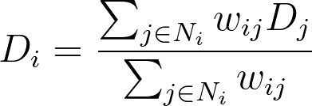
Shared Representative Filtering (SRF)
Main idea:
SRF is a filtering-based method
Given an incomplete depth map D and a complete color image C, we want to estimate the depth value D_{i} of an invalid pixel i by
Some Neighborhood around Pixel i
Depth Value of the valid pixel j
Weight determined by spatial and color information (in C)
15
Notes:
Like conventional filtering-based methods, SRF estimates the depth value of an invalid pixel by computing the weighted average of its neighborhood.
It’s worth noting that the samples used in the neighborhood should have valid depth values.

Slide 16
Shared Representative Filtering (SRF)
Main idea: change the way for collecting N_{i}
Regular filtering: use square window
➔ Both inefficient and inaccurate when the holes are large
To estimate the depth value of this background pixel:
49 pixels are invalid
22 pixels are on the (different) foreground surface
only 10 pixels are on the (same) background surface
Regular Filtering
16
Notes:
What makes our method effective is we change the way of choosing the neighborhood.
(click) We observed the square window used by regular filtering is both inefficient and inaccurate when the holes are large.
(click) Let me show this by an example: when using a 9x9 filter to reconstruct the depth value of this background pixel.
(click) In the square window, there are 49 invalid pixels. They are useless for the depth reconstruction,
(click) 22 pixels are on the foreground surface.
(click) In the end, we only have 10 pixels located on the background surface.

Slide 17
Shared Representative Filtering (SRF)
Main idea: change the way for collecting N_{i}
Our filtering: two-pass strategy
(1st Pass) Representative searching:
Find each pixel a valid and reliable representative depth
(2nd Pass) Depth reconstruction:
Predict the depth value of an invalid pixel using the representatives in a small local filter
Our Filtering
17
Notes:
To avoid using large square window, our method adopts a two-pass strategy for collecting the nearby valid samples.
(click) In the first pass, we find a valid and reliable representative for each pixel.
(click) In the second pass, we estimate the depth value of an invalid pixel by combining the depth values of its nearby representatives within a small local filter.
Because the representatives have both valid and reliable depth values, the filter size can be very small.

Slide 18
Shared Representative Filtering (SRF)
(1st Pass) Representative searching
Starting at an invalid pixel, we uniformly sample K directions and walk along the line to gather valid depth samples
We continue the search for a number of extra steps (called non-local samples)
A representative is selected among the samples based on similarities
18
Notes:
We first show how to select a representative for an invalid pixel.
(click) Starting at a pixel, we uniformly sample K directions and walk along the line to gather valid depth samples.
(click) Our search will not stop at the first valid sample. It will continue for a number of extra steps for finding non-local samples.
(click) After all valid samples along the sampling directions are collected, we select a representative based on their similarities.

Slide 19
Shared Representative Filtering (SRF)
(1st Pass) Representative searching
Non-local samples: consider a case where foreground object surround a background hole
w/o non-local samples
(we can only find foreground pixels)
w/ non-local samples
19
Notes:
One core idea of our method is the usage of non-local samples.
Consider a case where a background hole is surrounded by a foreground object. If we stop at the first valid samples, we can only find foreground pixels and cannot correctly fill the background hole.
(click) Using non-local samples enables us to find a better representative, a background pixel in this example.

Slide 20
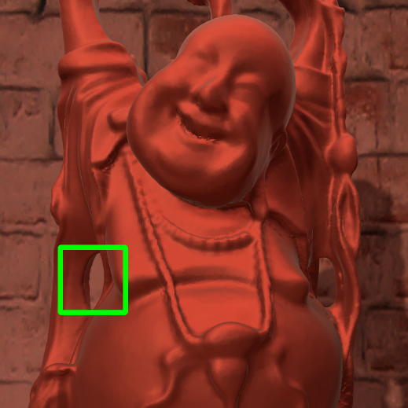
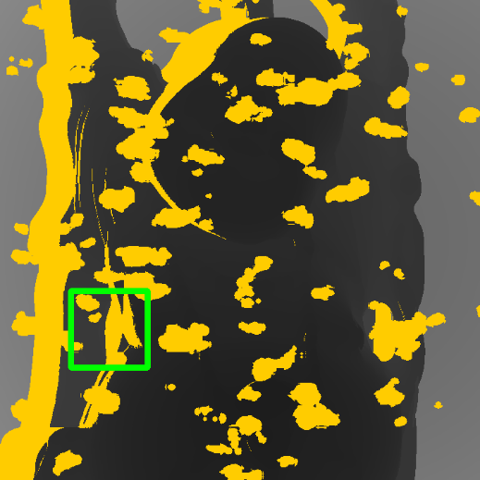



Shared Representative Filtering (SRF)
(1st Pass) Representative searching
Non-local samples: consider a case where foreground object surround a background hole
Input color/depth
w/o non-local
w/ non-local
reference
20
Notes:
This Buddha scene demonstrates a more realistic example for showing the benefits of non-local samples.

Slide 21
Shared Representative Filtering (SRF)
(1st Pass) Representative searching
Joint searching: reduce the number of required sampling directions
Stratify the search direction: choose a different initial sampling directions so that the adjacent pixels could discover different representatives
We use the following hash function:
21
Notes:
Another core idea of our method is using joint searching to reduce the number of required sampling directions.
(click) By stratifying the initial sampling directions of adjacent pixels, we can enforce nearby pixels to discover different representatives. We then combine them using a small local filter in the next stage.

Slide 22
Shared Representative Filtering (SRF)
(1st Pass) Representative searching
We measure the similarity of a representative j and a target pixel i using the following cost function:
Spatial Distance
Color Distance
Patch Distance
(non-local means)
P_{i} and P_{j}: vectors consisting of all color pixels in a 3 x 3 patch centered at pixel i and j
22
Notes:
Finally, the similarity of two pixels is measured by the following cost function.
(click) It consists of spatial distance, color distance, and patch distance based on the ideas of non-local means.

Slide 23
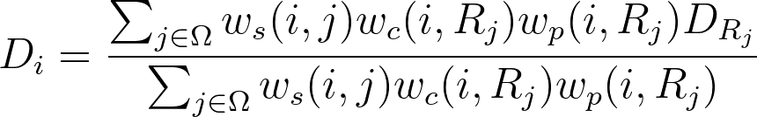
Shared Representative Filtering (SRF)
(2nd Pass) Depth reconstruction
The depth value D_{i} of an invalid pixel i is estimated by weighted averaging the depth values of the representatives in its small local neighborhood Ω.
Spatial Distance
Color Distance
Patch Distance
23
Notes:
After all representatives are found, in the second stage, we reconstruct the depth value of an invalid pixel by combining its nearby representatives within a small joint bilateral filter.
Similar to the cost function for selecting representatives, we include spatial, color and patch terms in our filter.

Slide 24
Multi-Resolution SRF
Notes:
So far I have introduced our single-resolution shared representative filtering.
We now extend it to work in a coarse-to-fine fashion for better performance and results.

Slide 25
Multi-Resolution SRF
For high-resolution inputs, the cost of searching a representative increases
Each direction requires more steps to find the first valid depth sample
We employ a multi-resolution scheme to reduce the searching cost
25
Notes:
For high-resolution inputs, the cost of SRF increases greatly because we need more steps to find the first valid sample in each searching direction.
We address this problem by running SRF in a multi-resolution manner.

Slide 26



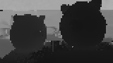



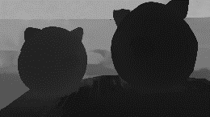

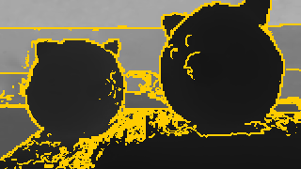



Multi-Resolution SRF
Color[n-1]
Color[n-2]
Color[0]
Depth
Upsampling
Depth
Upsampling
SRF
SRF
SRF
Filled Depth[n-1]
Filled Depth[n-2]
Filled Depth
Depth
Invalidation
Depth
Invalidation
Raw
Depth[n-1]
Raw
Depth[n-2]
Raw
Depth[0]
Downsampling
Coarsest Level
Finest Level
Depth invalidation: remove unreliable pixels
Compute depth gradients with a 3x3 Sobel filter
Remove the depth pixels whose gradients are larger than a threshold
26
Notes:
(click) Here we show the flowchart of our multi-resolution method.
(click) Our first step is to build an n-level pyramid by down-sampling the input color and depth images.
(click) We then start to fill the holes from the coarsest level using our single-resolution SRF.
(click) After we finish processing the coarsest level, for each remaining level, we upsample the result to a finer level.
(click) Because the upsampling process could produce inaccurate depth values at object boundaries, we apply depth invalidation for removing unreliable pixels. We do this by computing the depth gradients and erasing the pixels whose gradients are larger than a predefined threshold.
(click) After that, we fill the holes in the finer level using SRF again.
(click) (click) The process continues until we reach the finest level.

Slide 27
Multi-Resolution SRF
Our multi-resolution method not only improves efficiency, but also produces better results than SRF in most cases
Smoother results
Fewer texture copy artifacts
However, more levels do not always lead to better results
Image features will get lost or blurred
In our experiments, using 3 ~ 4 levels offers a good compromise between efficiency and quality in our test cases
27
Notes:
In most cases, our multi-resolution version not only improves efficiency but also produces better results than the single-resolution one. It can produce smoother results and reduce the texture copy artifacts.
(click) However, we observed that using more levels does not always lead to better results due to loss of image features in color and depth maps. We usually use 3 ~ 4 levels for a good compromise between efficiency and quality for HD or full-HD images.

Slide 28
Results
Notes:
Now let’s see some results.

Slide 29
Test Cases
We assess the performance and accuracy of our method using both synthetic and real-world RGB-D data
Simulated RGB-D data:
Generated by rendering 3D scenes and simulating holes using Unity
Middlebury 2014 data:
Generated by removing pixels from images in the Middlebury dataset
Real-world data:
Captured by an Intel RealSense D-435 RGB-D camera
29
Notes:
We use three types of inputs to test the accuracy of our method, including both synthetic and real-world RGB-D data.
First, we generate fully synthetic data by rendering 3D scenes and simulating holes using Unity.
Next, we remove depth pixels from the images in the Middlebury dataset.
Finally, we capture several sets of real-world data using Intel RealSense.

Slide 30
Compared Methods
We compare with the following methods
Joint-bilateral filtering (JBF) [Kopf et al. 2007] and its multi-resolution version (M-JBU) [Richardt et al. 2012]
Our singe-resolution shared representative filtering (SRF) and its multi-resolution version (M-SRF)
The fast bilateral solver (FBS) [Barron and Poole 2016]
The above methods are implemented using Unity shaders
30
Notes:
We compare with the following methods:
(click) The single-resolution joint-bilateral filtering and its multi-resolution variant.
(click) Our single-resolution shared representative filtering and our multi-resolution version.
We implement above methods using Unity shaders.
(click) We also include a global optimization method, the fast bilateral solver, for quality comparison

Slide 31
Simulated RGB-D Data: Time Budget
We allocate 15 ms. for single-res. methods (JBF/SRF) and 7.5 ms. for multi-res. Methods (M-JBU/M-SRF)
To meet a given time budget:
For JBF and M-JBU, we tune the filter size (2x the spatial standard deviation
For SRF and M-SRF, we tune the number of sampling lines K
For FBS, we used the author’s Python version. It takes about 300 ~ 500 ms.
31
Notes:
Let’s first look at the simulated RGB-D data.
We allocate fixed time budgets for equal-time comparisons: 15 and 7.5 ms. for single-resolution and multi-resolution methods, respectively.
(click) For joint bilateral filtering, the only way to increase samples is using a larger filter, so we tune the filter size for meeting a given time budget. For our method, we tune the number of sampling lines K.
(click) For fast bilateral solver, we used the author’s Python version running on CPU. We only use its results for quality comparison.

Slide 32
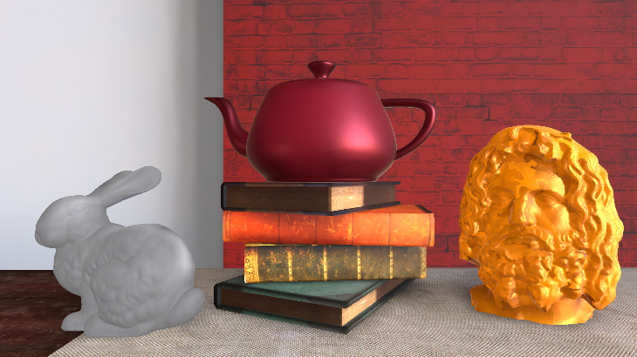
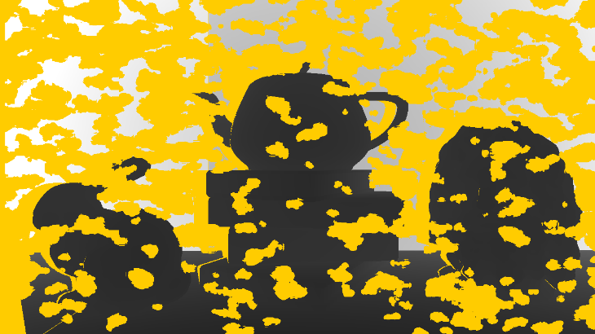
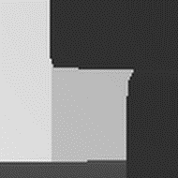


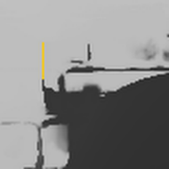
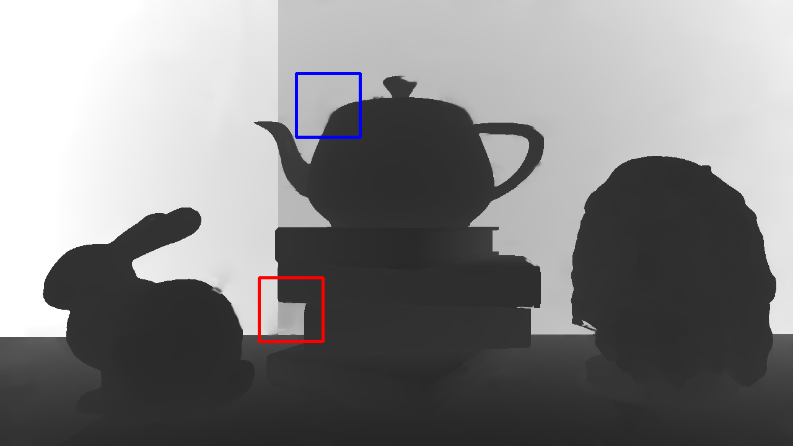
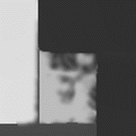
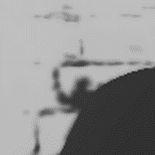
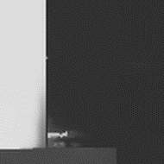
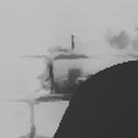

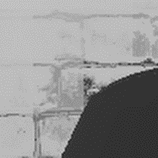
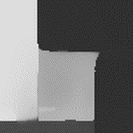
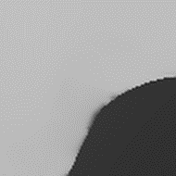
Simulated RGB-D Data: Table
REF
MAE PSNR
Inputs
JBF 15 ms.
N/A N/A
SRF 15 ms.
0.0399 29.19
M-JBU 7.5 ms.
0.0654 26.02
M-SRF (our method) 7.5 ms.
FBS
0.0511 29.77
M-SRF 7.5 ms.
0.0308 31.71
32
Notes:
This page shows the comparisons on the Table scene.
The red ROI shows an region of complex occlusion while the blue ROI shows an region of similar foreground and background colors.
Our SRF produces better results than joint bilateral filtering and our multi-resolution SRF produces the best results among all compared methods.
In the blue ROI, it also shows that our multi-resolution method can reduce the texture copy artifacts.

Slide 33
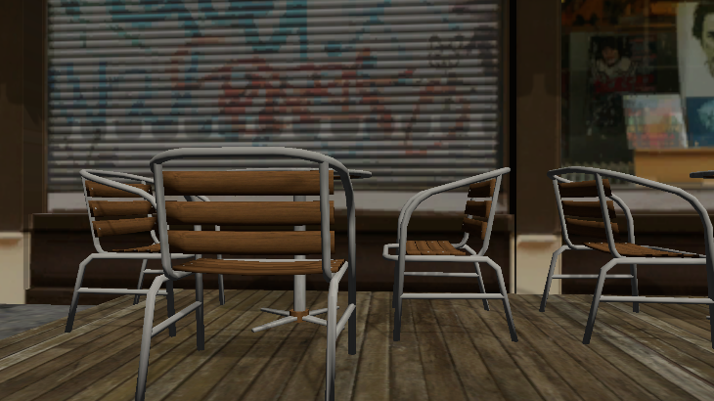
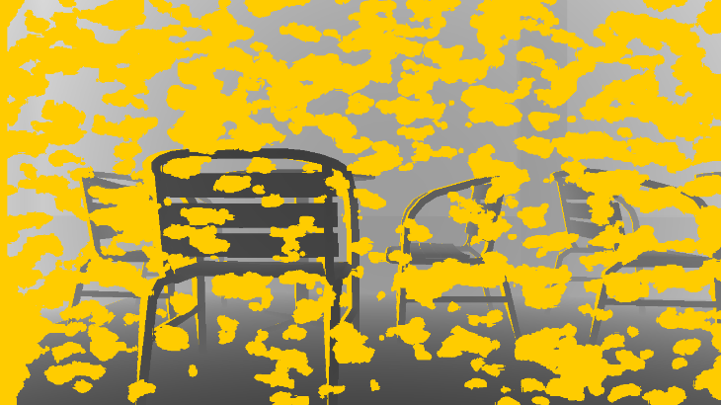
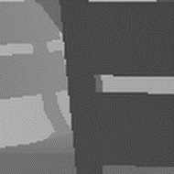
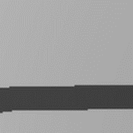


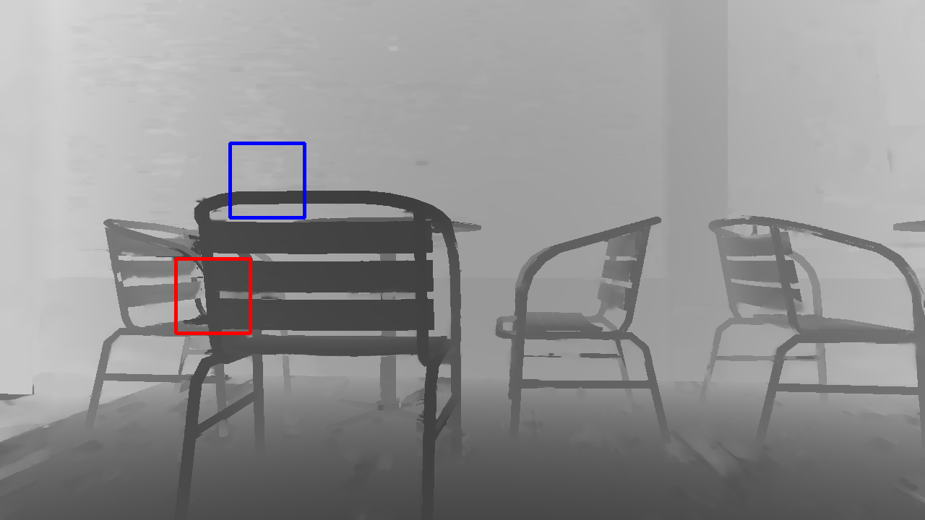
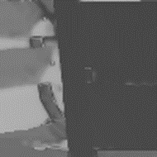
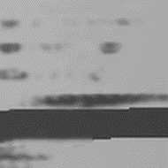
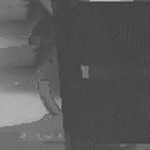
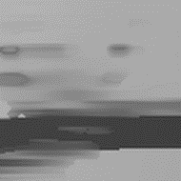

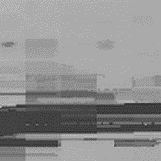
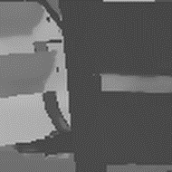
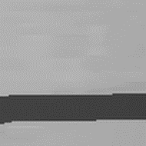
Simulated RGB-D Data: Outdoor
REF
MAE PSNR
Inputs
JBF 15 ms.
N/A N/A
SRF 15 ms.
0.0678 27.63
M-JBU 7.5 ms.
0.1046 25.91
M-SRF (our method) 7.5 ms.
FBS
0.0766 27.09
M-SRF 7.5 ms.
0.0694 28.01
33
Notes:
The outdoor scene shows a difficult case for complex geometry and occlusion.
Our multi-resolution SRF produces the fewest artifacts and the most visually pleasing results.

Slide 34
Ablation Study: Table Scene
[Ours] SRF
M-JBU (2 levels)
[Ours] M-SRF (2 levels)
M-JBU (3 levels)
[Ours] M-SRF (3 levels)
M-JBU (4 levels)
[Ours] M-SRF (4 levels)
Number of samples (Time) v.s. accuracy
M-JBU can only increase samples by enlarging filter size, which might introduce additional bias
Our method can increase samples by using more sampling lines, and is robust to a larger number of samples
34
Notes:
We conduct an experiment for investigating the relationship between number of samples and accuracy.
As discussed previously, the only way to increase samples for multi-resolution joint bilateral upsampling is using a larger filter. However, as shown from the figure, the error does not always drop as the number of samples increases. The reason is using a larger filter will include too many samples from other surfaces and could introduce additional bias.
On the other hand, the error produced by our method decreases consistently as the number of sampling directions increases.

Slide 35
Middlebury 2014 Data: Time Budget
The images have high resolutions (around 3000 x 2000)
We allocate 20 ms. for M-JBU and M-SRF
For FBS, we used the author’s Python version. It takes about 1200 ~ 2000 ms.
35
Notes:
For the Middlebury dataset, we only run multi-resolution methods because their images have very high resolutions.
We allocate 20 ms. for the time budget.
Also, we include the fast bilateral solver for quality comparison.

Slide 36
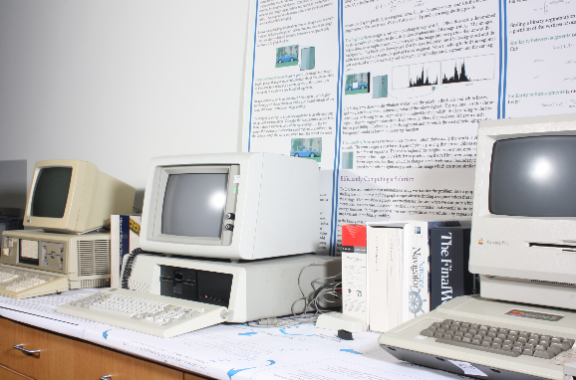
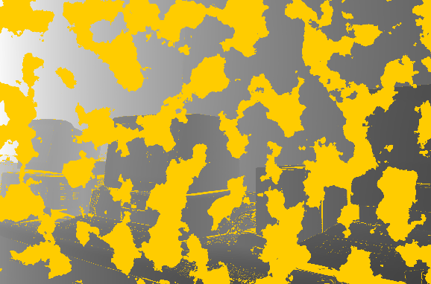
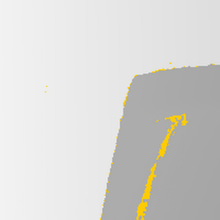

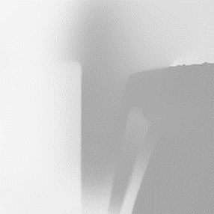
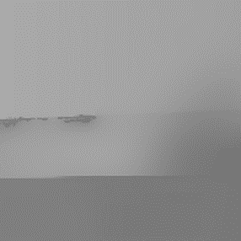
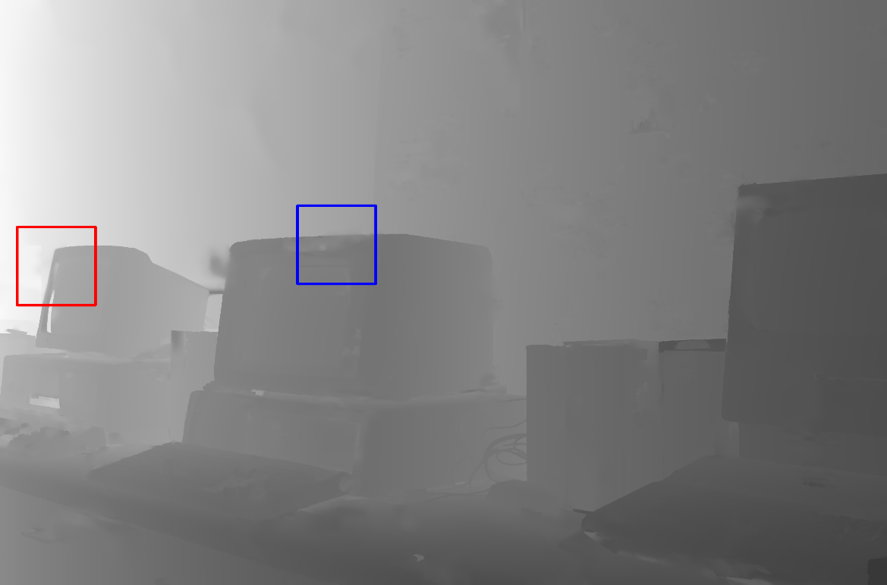




Middlebury 2014 Data: Vintage
REF
MAE PSNR
Inputs
M-JBU 20 ms.
0.0300 33.16
FBS
0.0233 36.71
M-SRF (our method) 20 ms.
M-SRF 20 ms.
0.0204 38.25
36
Notes:
We show the comparison of the Vintage scene here.
In this case, the background and foreground objects have very similar colors, which will confuse the bilateral filtering.
Compared to previous methods, our method can better preserve depth discontinuities.

Slide 37
Middlebury 2014 Data: All MAE
 | M-JBU | FBS | M-SRF
MAE | 0.0429 | 0.0404 | 0.0323
0.753×
0.800×
37
Notes:
Our method also produces smaller mean-absolute error

Slide 38
Middlebury 2014 Data: All PSNR
 | M-JBU | FBS | M-SRF
PSNR | 32.14 | 33.95 | 35.13
-2.99dB
-1.18dB
38
Notes:
and higher PSNR in Middlebury dataset.

Slide 39
Real-World Data: Time Budget
We allocate 15 ms. for single-res. methods (JBF/SRF) and 7.5 ms. for multi-res. Methods (M-JBU/M-SRF)
To meet a given time budget:
For JBF and M-JBU, we tune the filter size (2x the spatial standard deviation
For SRF and M-SRF, we tune the number of sampling lines K
For FBS, we used the author’s Python version. It takes about 300 ~ 500 ms.
39
Notes:
Finally, we test with real-world data.
The time budgets are set as in simulated RGB-D data.
Let’s see two examples.

Slide 40















Real-World Data: Puppies
JBF 15 ms.
Inputs
SRF 15 ms.
M-JBU 7.5 ms.
JBF 166.7 ms.
M-SRF (our method) 7.5 ms.
FBS
M-SRF 7.5 ms.
40
Notes:
The puppies scene has very large missing regions due to image alignment, occlusion and shiny surface.
The colors of the foreground and background in the blue ROI are very similar.
The red ROI is close to the image boundaries, it shows a difficult case for conventional filters because there are fewer samples in the window.
Our method can better preserves object boundaries in both challenging cases.

Slide 41















Real-World Data: Man
JBF 15 ms.
Inputs
SRF 15 ms.
M-JBU 7.5 ms.
JBF 98.6 ms.
M-SRF (our method) 7.5 ms.
FBS
M-SRF 7.5 ms.
41
Notes:
The man scene has a relatively small fraction of missing region; however, the holes between the man’s shoulder and hand are very difficult for conventional filters.
Our method can adapt to the shape of missing regions. Our non-local samples also allow us to find background pixels blocked by the hand.

Slide 42




Limitations
Still oversmooth depth maps when color similarity does not lead to depth similarity
Inaccurate depth estimation at thin geometry and complex occlusion
42
Notes:
While our method significantly improves over joint bilateral filtering, it inherits some of its limitations.
It could still oversmooth depth maps when color similarity does not lead to depth similarity. For example, the highlight on the teapot.
It could also inaccurately estimate the depth values of fine geometry under complex occlusion.

Slide 43
Conclusion and Future Work
Notes:
Finally, I would like to conclude our work and propose some future research directions.

Slide 44
Conclusion
We propose shared representative filtering (SRF), a depth completion algorithm for RGB-D data
Adapt the filter to the geometry of the missing regions
Can effectively handle large holes
Our multi-resolution SRF further improves accuracy and efficiency, achieving real-time frame rate on HD and Full-HD resolution images
44
Notes:
We propose a new filtering-based method called shared representative filtering for real-time depth completion.
It is effective for dealing with large holes thanks to better adapting to the geometry of the missing regions.
(click) We further extend our SRF by running it in a coarse-to-fine fashion, which improves both accuracy and efficiency.

Slide 45
Future Work
Extend our method to the temporal domain for RGB-D videos
Exploit temporal coherence to improves temporal consistency and reduces per-frame cost
Leverage the success of previous research on scene understanding, such as image segmentation or depth edge detection
45
Notes:
In the future, we would like to extend our method to the temporal domain for processing videos.
(click) Another interesting direction is to leverage the success of previous research on scene understanding. For example, we can exploit the results of segmentation and depth edge detection to better identify the depth boundaries, instead of just using color information only.

Slide 46
Thanks for your attention Q/A
Notes:
That’s all for my presentation. Thanks.

Slide 47
Backup Slides
Notes:
Let’s conclude our work and propose some future research directions.

Slide 48
Ablation Study
Number of sampling directions v.s. accuracy
Notes:
We have conducted an ablation study to investigate the relationship between number of sampling directions and the accuracy. As shown from the results, the error drops consistently as the number of sampling directions increases. We usually use 8-24 directions per pixel to compromise between accuracy and performance.

Slide 49
Ablation Study
Color standard deviation (σ_{c}) v.s. accuracy:
Our method produces smaller error and is less sensitive to the color standard deviation
Notes:
In the previous experiment, we tune the color standard deviation of each method for each scene.
Here we show the results of sigma_c verus accuracy.
For all test scenes, our method produces smaller error than M-JBU. Our method is also less sensitive to the color standard deviation.

Slide 50
Comparison with Shared Matting
Shared matting
Gastal and Oliveira [2010] adopted a similar idea of stratified line search for image matting
Our method has several features that are specifically designed for depth completion
Extra non-local samples
Multi-resolution version for better efficiency and reducing texture copy artifacts

Slide 51
Generation of Simulated RGB-D Data
Given a 3D virtual scene in Unity
Render color and reference depth images with the camera pose of color sensor
Render world-space position of the surfaces with the camera pose of depth sensor and reproject to the view of the color sensor
Compute per-pixel glossiness and distance terms to remove pixels for simulating real-world data

